Slide 1

Memory-Speed Virtual Distributed Storage
Bin Fan, Yupeng Fu
August 2016 @ 小象学院微课
© 2016 Alluxio Confidential

Slide 2
About Us
Bin Fan
Software Engineer @ Alluxio, Inc.
Alluxio PMC
Worked at Google, MSR
CMU, CUHK, USTC
Wechat ID: apc999_fb
Yupeng Fu
Software Engineer @ Alluxio, Inc.
Alluxio PMC
Worked at Palantir, Google
UCSD, Tsinghua
Wechat ID: richbird9
2

Slide 3







TEAM
Team consists of Alluxio creators and top committers
Invested by
Committed to Alluxio Open Source
http://www.alluxio.com

Slide 4
Outline
Industry Trend & Alluxio Overview
Features and Use Cases
Architecture
How to Contribute
Summary
4
Notes:
Introduction and why Alluxio

Slide 5
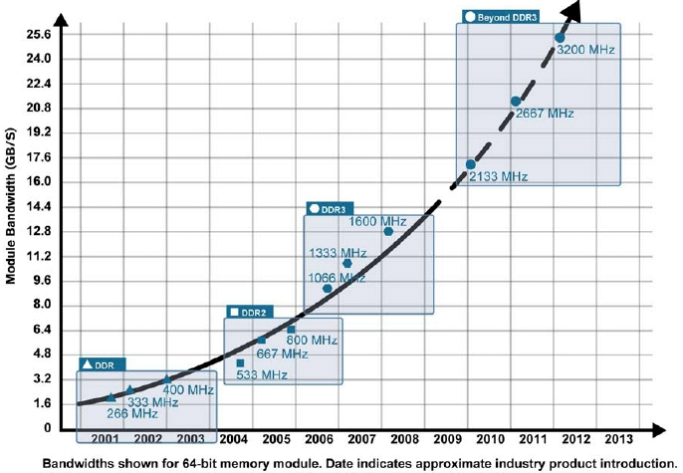
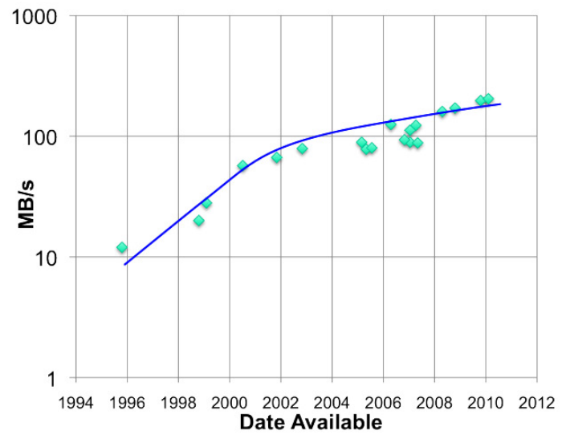
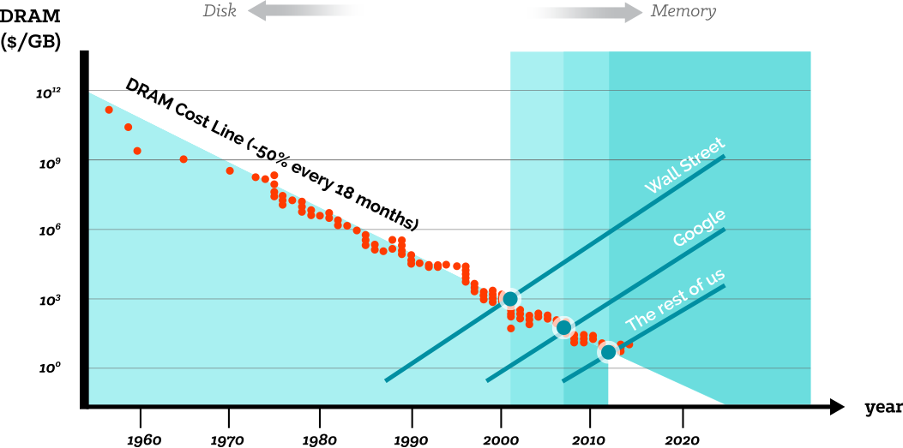
HARDWARE TRENDS
RAM throughput increasing exponentially
Disk throughput increasing slowly
Memory prices halving every 18 months
Memory Locality is the Key!

Slide 6


BIG DATA ECOSYSTEM YESTERDAY
Notes:
十年前，HADOOP AND MAPREDUCE在YAHOO诞生，生态系统比较简单，计算是MAPREDUCE, 存储是HDFS. 业界得到了快速的发展。
今天在上册为了不同的计算目标，有不同的计算引擎。至少5，6是个针对不同需求
存储引擎也是根据不同需求来选择
生态系统的链接是很复杂的问题，这时候我们引用了Alluxio引擎系统
半年前我们从tachyon更名为Alluxio
我们为上层提供统一的命名空间
是的任何一个寄存一内存级别的速度和不同存储中的数据进行交互
是不是应该着重提一下云存储?

Slide 7








BIG DATA ECOSYSTEM TODAY
…
…
Notes:
十年前，HADOOP AND MAPREDUCE在YAHOO诞生，生态系统比较简单，计算是MAPREDUCE, 存储是HDFS. 业界得到了快速的发展。
今天在上册为了不同的计算目标，有不同的计算引擎。至少5，6是个针对不同需求
存储引擎也是根据不同需求来选择
生态系统的链接是很复杂的问题，这时候我们引用了Alluxio引擎系统
半年前我们从tachyon更名为Alluxio
我们为上层提供统一的命名空间
是的任何一个寄存一内存级别的速度和不同存储中的数据进行交互
是不是应该着重提一下云存储?

Slide 8
BIG DATA ECOSYSTEM ISSUES
…
…
Notes:
十年前，HADOOP AND MAPREDUCE在YAHOO诞生，生态系统比较简单，计算是MAPREDUCE, 存储是HDFS. 业界得到了快速的发展。
今天在上册为了不同的计算目标，有不同的计算引擎。至少5，6是个针对不同需求
存储引擎也是根据不同需求来选择
生态系统的链接是很复杂的问题，这时候我们引用了Alluxio引擎系统
半年前我们从tachyon更名为Alluxio
我们为上层提供统一的命名空间
是的任何一个寄存一内存级别的速度和不同存储中的数据进行交互
是不是应该着重提一下云存储?

Slide 9

BIG DATA ECOSYSTEM WITH ALLUXIO
…
Native File System
Hadoop Compatible File System
Native Key-Value Interface
FUSE Compatible File System
Enabling any application to access data from any storage system
at memory-speed
…
Notes:
十年前，HADOOP AND MAPREDUCE在YAHOO诞生，生态系统比较简单，计算是MAPREDUCE, 存储是HDFS. 业界得到了快速的发展。
今天在上册为了不同的计算目标，有不同的计算引擎。至少5，6是个针对不同需求
存储引擎也是根据不同需求来选择
生态系统的链接是很复杂的问题，这时候我们引用了Alluxio引擎系统
半年前我们从tachyon更名为Alluxio
我们为上层提供统一的命名空间
是的任何一个寄存一内存级别的速度和不同存储中的数据进行交互
是不是应该着重提一下云存储?

Slide 10
ATTRIBUTES
Scale out architecture.
Memory-speed access to data.
Memory-Speed
Virtual
Distributed
Storage
Virtualized across different storage types under a unified namespace.
Non-persistent data-storage software.

Slide 11
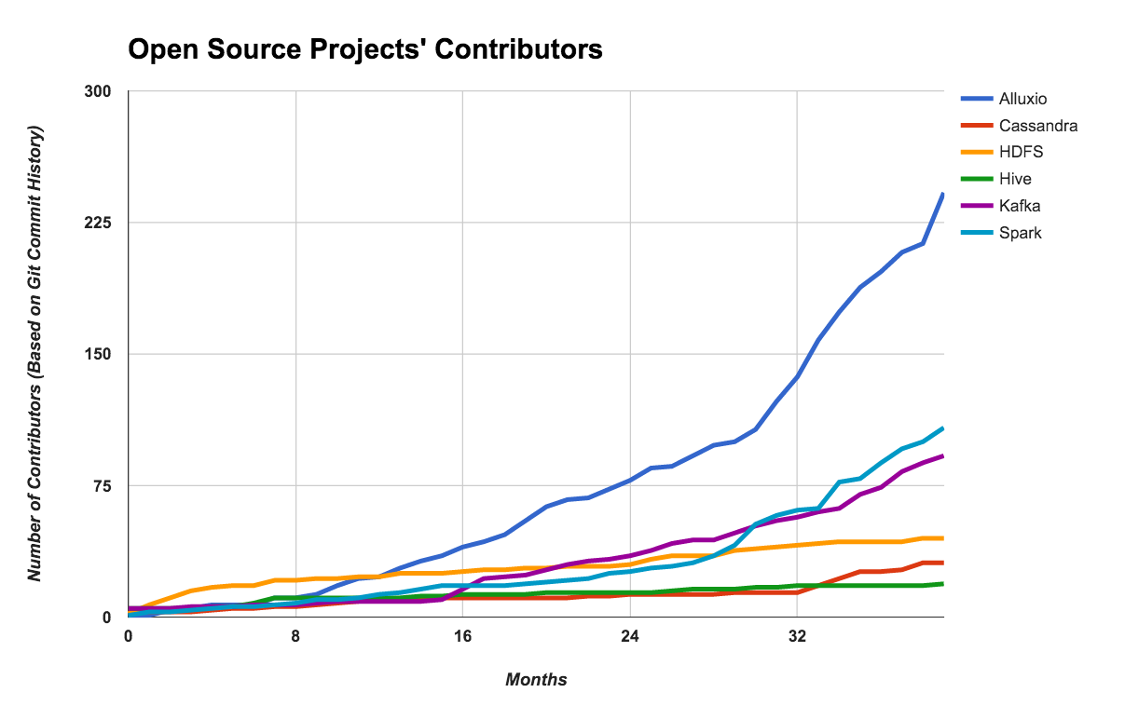
OPEN SOURCE ALLUXIO
The fastest growing open-source project in the big data ecosystem
Currently over 300 contributors from over 100 organizations

Slide 12
Outline
Industry Trend & Alluxio Overview
Features and Use Cases
Architecture
How to Contribute
Summary
12
Notes:
Introduction and why Alluxio

Slide 13
CASE 1:
Off-heap Memory Storage to Alleviate Resource Pressure
Application 1
Alluxio
13

Slide 14
Consolidating Memory
storage engine &
execution engine
same process
Spark Job1
Spark Job2
Spark
Memory
Spark
Memory
block 1
block 3
block 3
block 1
HDFS / Amazon S3
block 1
block 2
block 3
block 4
Data duplicated at memory-level
14

Slide 15
Consolidating Memory
storage engine &
execution engine
same process
Spark Job1
Spark Job2
Spark mem
Spark mem
HDFS
disk
Alluxio In-Memory
block 1
block 1
block 2
block 3
block 3
block 4
block 4
HDFS / Amazon S3
block 1
block 2
block 3
block 4
Data not duplicated at memory-level
15

Slide 16
Data Resilience during Crashes
Spark Task
storage engine &
execution engine
same process
Spark Memory
block manager
block 1
block 3
HDFS / Amazon S3
block 1
block 2
block 3
block 4
Process crash requires network and/or disk I/O to re-read the data
16

Slide 17
Data Resilience during Crashes
Crash
storage engine &
execution engine
same process
Spark Memory
block manager
block 1
block 3
HDFS / Amazon S3
block 1
block 2
block 3
block 4
Process crash requires network and/or disk I/O to re-read the data
17

Slide 18
Data Resilience during Crashes
storage engine &
execution engine
same process
Crash
HDFS / Amazon S3
block 1
block 2
block 3
block 4
Process crash requires network and/or disk I/O to re-read the data
18

Slide 19
Data Resilience during Crashes
storage engine &
execution engine
same process
Spark Task
Spark Memory
block manager
Alluxio In-Memory
HDFS
disk
block 1
block 1
block 2
block 3
block 4
block 3
block 4
Process crash only needs memory I/O to re-read the data
19

Slide 20
Data Resilience during Crashes
storage engine &
execution engine
same process
Crash
Alluxio In-Memory
HDFS
disk
block 1
block 1
block 2
block 3
block 4
block 3
block 4
Process crash only needs memory I/O to re-read the data
20

Slide 21





CASE STUDY
Thanks to Alluxio, we now have the raw data immediately available at every iteration and we can skip the costs of loading in terms of time waiting, network traffic, and RDBMS activity.
- Henry Powell, Barclays
Share Data Across Jobs at Memory Speed
Relational Database
RESULTS
Barclays workflow iteration time decreased from hours to seconds
Alluxio enabled workflows that were impossible before
By keeping data only in memory, the I/O cost of loading and storing in Alluxio is now on the order of seconds
Reducing time from hours to seconds
Solving issues of Teradata as under storage

Slide 22
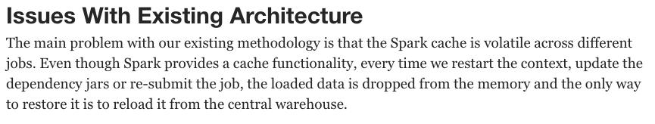
Barclays Previous Architecture
Spark
Slow ETL,
30+ minutes
Each context restart requires ETL process again
Teradata
https://dzone.com/articles/Accelerate-In-Memory-Processing-with-Spark-from-Hours-to-Seconds-With-Tachyon
22

Slide 23
Barclays Architecture with Alluxio
Spark
ETL only once
Data still available in Alluxio memory after Job crash
Alluxio
Teradata
23

Slide 24
CASE 2:
Fast Data sharing between jobs
Application 1
Application2
Alluxio
HDFS
24

Slide 25
Data Sharing Between Frameworks
storage engine &
execution engine
same process
Spark Job
Hadoop MR Job
Spark
Memory
YARN
block 1
block 3
HDFS / Amazon S3
block 1
block 2
block 3
block 4
Inter-process sharing slowed down by network and/or disk I/O
25

Slide 26
Data Sharing Between Frameworks
storage engine &
execution engine
same process
Spark Job
Hadoop MR Job
Spark Memory
YARN
HDFS
disk
Alluxio In-Memory
block 1
block 1
block 2
block 3
block 3
block 4
block 4
HDFS / Amazon S3
block 1
block 2
block 3
block 4
Inter-process sharing can happen at memory speed
26

Slide 27


CASE STUDY
We’ve been running Alluxio in production for over 9 months, resulting in 15x speedup on average, and 300x speedup at peak service times.
- Xueyan Li, Qunar
Sharing Across Different Storage Compute Frameworks
RESULTS
Multiple computing frameworks can share data at memory speed with Alluxio
Improved the performance of their system with 15x – 300x speedups
Alluxio provides various user-friendly APIs, which simplifies the transition to Alluxio.
6 billion logs (4.5 TB) daily
Mix of Memory + HDD

Slide 28
Qunar Previous Architecture
Spark Streaming
Flink Streaming
Spark
Flink
Some jobs cannot finish
Slow access to the storage
HDFS Cluster
28
Notes:
用于存放输入和输出数据的HDFS位于一个远程存储集群中（物理位置上位于另一个机房）。本地计算集群与远程存储集群存在较高的网络延迟，频繁的远程数据交换成为整个流处理过程的一大瓶颈； HDFS的设计是基于磁盘的，其I/O性能，尤其是写数据性能难以满足流式计算所要求的延时；Spark Streaming在进行计算时，每个Spark executor都要从HDFS中读取数据，重复的跨机房读文件操作进一步地的拖慢了流式计算的整体效率
Spark Streaming在进行计算时，每个Spark executor都要从HDFS中读取数据，重复的跨机房读文件操作进一步地的拖慢了流式计算的整体效率
Some job cannot finish 对整个pipeline影响更大

Slide 29
Qunar Architecture with Alluxio
Spark Streaming
Flink Streaming
Spark
Flink
Alluxio
Share in-memory data across frameworks
HDFS Cluster
29
Notes:
在新的系统架构中，最初的输入数据仍然经过Kafka过滤，交由Spark Streaming消费，不同的是，Spark Streaming在计算时产生的大量中间结果以及最终的输出都存放在Alluxio中，避免与较慢的远程HDFS集群进行交互，同时，存放在Alluxio中的数据也能够很方便地与上层组件，如Flink
跨计算框架数据共享

Slide 30
CASE 3:
Accelerate access to remote storage
Application
Alluxio
Remote Storage
30
Notes:
远端存储和云存储

Slide 31
Decoupling Compute from Storage
Different compute and storage hardware requirements
Scale compute and storage resources independently
Traditional filers/SANs and cost effective object stores (Amazon S3, Google GCS, Microsoft Azure Blob Store) are inherently decoupled
Accessing data
requires remote I/O!
31
Notes:
云存储
稳定，安全，可靠

Slide 32
Remote I/O problems
Application
high latency, network throughput
every data operation requires data transfer, sometimes over the WAN
Remote Storage
32

Slide 33
Visualizing the Stack with Alluxio
Application
FAST
10⁴ - 10⁵ MB/s
Often
Alluxio MEM
MODERATE
10³ - 10⁴ MB/s
Limited
Alluxio SSD/HDD
SLOW
10² - 10³ MB/s
Only When Necessary
Remote Storage
33

Slide 34

CASE STUDY
The performance was amazing. With Spark SQL alone, it took 100-150 seconds to finish a query; using Alluxio, where data may hit local or remote Alluxio nodes, it took 10-15 seconds.
- Shaoshan Liu, Baidu
Accelerate Access to Remote Storage
Baidu File System
RESULTS
Data queries are now 30x faster with Alluxio
1000-worker Alluxio cluster run stably, providing over 50TB of RAM space
By using Alluxio, batch queries usually lasting over 15 minutes were transformed into an interactive query taking less than 30 seconds
200+ nodes deployment
2+ petabytes of storage
Mix of memory + HDD
1000-worker cluster

Slide 35
CASE 4:
Unified Name Space
Application
Alluxio
AWS S3
HDFS
35

Slide 36
Unified Name Space
An abstraction that makes it possible for applications to access different storage systems through the same interface
…
Native File System
Hadoop Compatible File System
Native Key-Value Interface
FUSE Compatible File System
…
36
Notes:
Alluxio: Memory Speed Virtual Distributed Storage
Enables Virtualized Data Across Multiple Types of Storage

Slide 37
Common Scenarios
At large organizations, data spans many storage systems
Application logic needs to integrate with different storage systems
Legacy storage systems
37

Slide 38
Transparent Naming
Alluxio
Storage System (HDFS, S3, …)
alluxio://host:port/
hdfs://host:port/
Data
Users
Data
Users
Reports
Sales
Alice
Bob
Reports
Sales
Alice
Bob
Operations over persisted Alluxio objects mapped transparently to underlying storage
alluxio://Data/Sales -> hdfs://Data/Sales
38

Slide 39
Multiple Storage Systems
Alluxio
Storage System A
alluxio://host:port/
hdfs://host:port/
Storage System B
Users
s3://host/bucket
Data
Users
Alice
Bob
Reports
Sales
Reports
Sales
Alice
Bob
Unified namespace for multiple data sources
alluxio://Data/Sales -> s3://bucket/Sales
alluxio://Users/Alice -> hdfs://Users/Alice
API for on-the-fly mounting / unmounting
39

Slide 40









A Proliferation of Under Storage Systems
MORE…
40

Slide 41
CASE STUDY
An Internet Company
RESULTS
Transparently Manage Data Across Different Storage Systems
Alluxio’s unified namespace enables different applications and frameworks to easily interact with their data from different storage systems
Global data centers across North America and Asia
Tiered storage feature manages various storage resources including memory, SSD and disk
Machine Learning Pipelines
Storage medium: MEM
Clusters in different regions

Slide 42




BENEFITS
Performance
Flexibility
Agility
Cost
High performance data access
New workflows across existing data and access data in any storage system
Work with the compute and storage frameworks of your choice
Grow compute and storage systems independently

Slide 43
Outline
Industry Trend & Alluxio Overview
Features and Use Cases
Architecture
How to Contribute
Summary
43
Notes:
Introduction and why Alluxio

Slide 44
Architecture
Master
Workers
Clients
UnderFileSystem
44

Slide 45
Alluxio Files
Files are composed of fixed-sized blocks
The last block of a file is not required to be the full block size
Files are immutable once completed
Alluxio stores blocks on Alluxio workers
Blocks are not required to be together with other blocks of the same file
Block 1
Block 2
Block 3
Block 4
Alluxio File
45

Slide 46
Alluxio Architecture
Standby Master
Alluxio
Worker
Under File System
ramdisk
Zoo keeper
Alluxio
Master
Alluxio
Worker
ramdisk
Under File System
Standby Master
Alluxio
Worker
ramdisk
46

Slide 47
Alluxio Clients
Applications interact with Alluxio via the Alluxio Client
Java Clients
Native Alluxio Java Client
HDFS-compatible Client
Fuse Client
Can mount Alluxio to the local file system
Key-Value Client (alpha)
47

Slide 48
UnderFileSystem (UFS)
Data is persisted in existing storage systems
Called Under File System in Alluxio terminology
Alluxio abstracts away different UnderFileSystems
When a UFS is mounted, Alluxio transparently links the UFS namespace with Alluxio namespace
48

Slide 49

How to use Alluxio
Use Spark as example:
Without HDFS:
With Alluxio:
scala> val file = sc.textFile(“hdfs://ip:port/path”)
scala> val file = sc.textFile(“alluxio://ip:port/path”)
49

Slide 50
Outline
Industry Trend & Alluxio Overview
Features and Use Cases
Architecture
How to Contribute
Summary
50
Notes:
Introduction and why Alluxio

Slide 51
Alluxio Code Organization
51

Slide 52
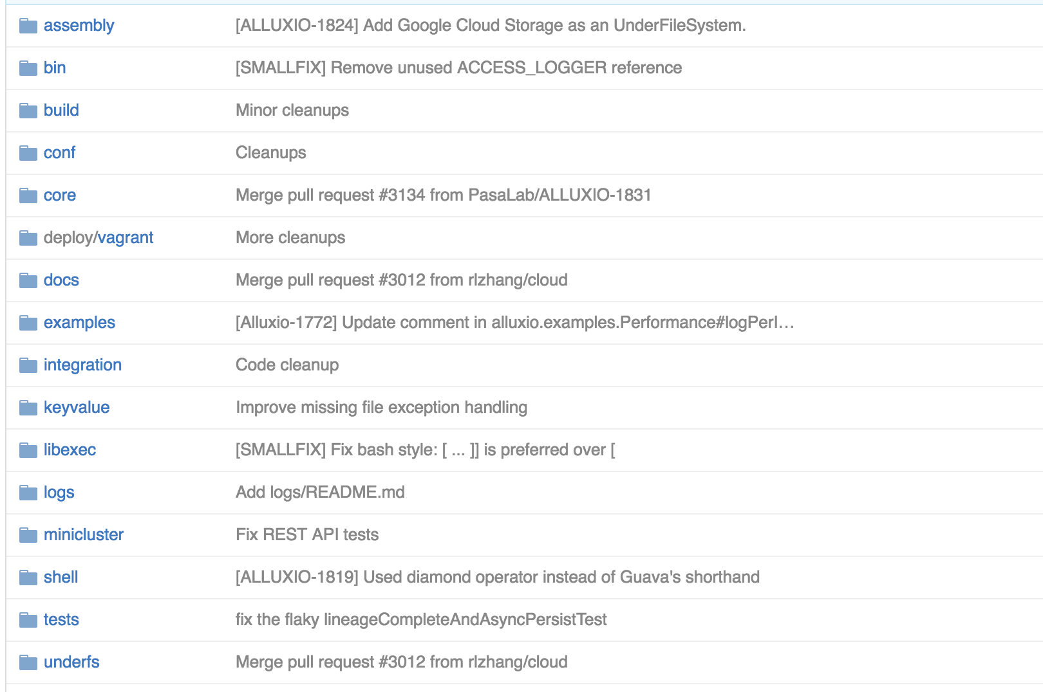
Alluxio Open Source Folder Structure
52

Slide 53
Scripts and Configurations
bin/ shell scripts for Alluxio
build/ tools and configuration for building
conf/ configuration settings for Alluxio
deploy/ scripts for deploying Alluxio
libexec/ internal libraries
53

Slide 54
Tests, Examples, Documentation
docs/ documentation files
examples/ examples of using Alluxio
minicluster/ in-process Alluxio for testing
tests/ unit tests (using in-process Alluxio)
54

Slide 55
Alluxio Java Source Code
core/ Alluxio client, worker, master code
integration/ Mesos, Yarn, Fuse integration
keyvalue/ key-value functionality
shell/ the Alluxio Shell implementation
underfs/ under filesystem implementations
55

Slide 56
Contributing to Alluxio Workflow
Create Github account
https://github.com/
Adding an email address to your GitHub account
http://tinyurl.com/hn3eo2x
56

Slide 57
Contributing to Alluxio Workflow
Sign up on JIRA
View JIRA Alluxio project
https://alluxio.atlassian.net/
Take a New Contributor JIRA Ticket
New Contributor Tasks: http://tinyurl.com/zamx2xn
Assign tickets to yourself
http://tinyurl.com/hn3eo2x
57

Slide 58
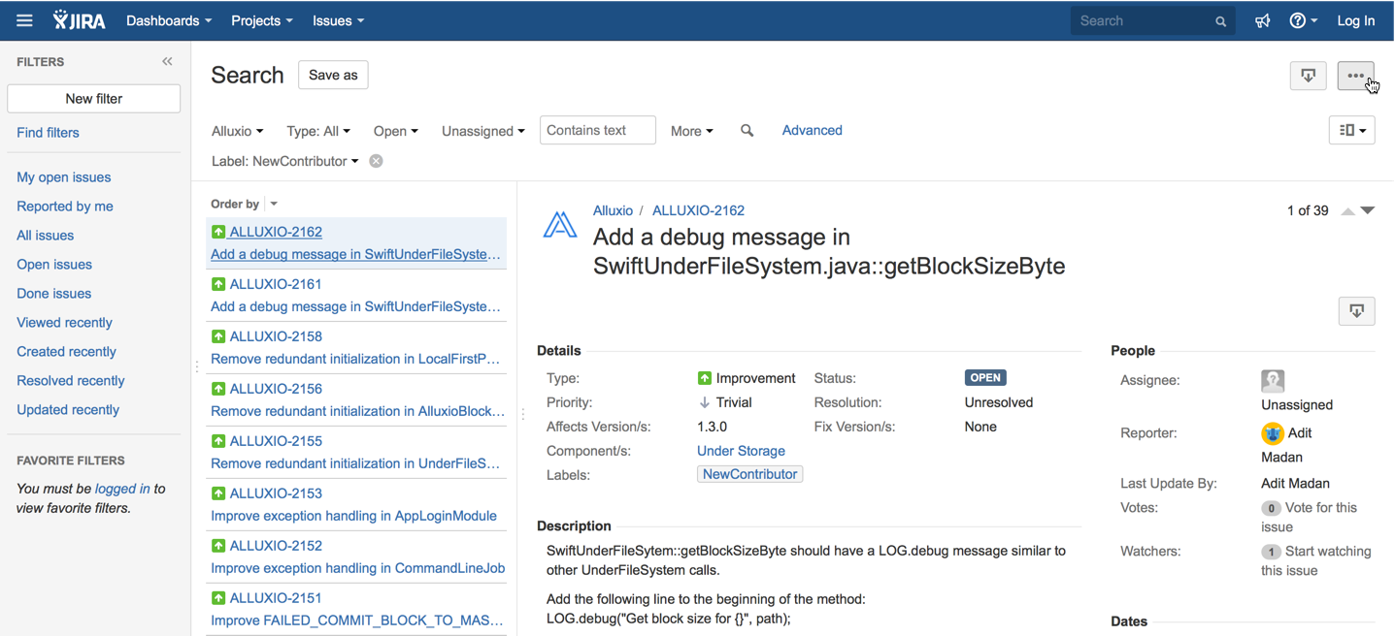
Contributing to Alluxio Workflow
http://tinyurl.com/hn3eo2x

Slide 59
Contributing to Alluxio Workflow
Fork Alluxio on Github
Make a local clone
Configure your Git email
$ git clone https://github.com/YOUR-USERNAME/alluxio.git
$ cd alluxio
$ git config --global user.email "your_email@example.com"
http://tinyurl.com/hn3eo2x
59

Slide 60
Contributing to Alluxio Workflow
Develop in local repository
Submit Pull Requests
Code reviews are done in Pull Requests
Pull Requests merged after 2 LGTM’s
“looks good to me”
http://tinyurl.com/hn3eo2x
60

Slide 61
Outline
Industry Trend & Alluxio Overview
Features and Use Cases
Architecture
How to Contribute
Summary
61
Notes:
Introduction and why Alluxio

Slide 62
Takeaway: When to use Alluxio
Two or more jobs access the same dataset
Job(s) may not always succeed
Spark with memory/GC pressure
Jobs/Apps are pipelined
Resulting data does not need to be immediately persisted
Interact with remote data
Data stored across different storage systems
62

Slide 63
Join the community
Follow the contribution workflow and create a PR
http://tinyurl.com/hn3eo2x
63

Slide 64
Try out Alluxio 1.2.0
http://www.alluxio.org/releases
64

Slide 65
Resources
Alluxio Project: http://www.alluxio.org
Development: https://github.com/Alluxio/alluxio
Meet Friends: http://www.meetup.com/Alluxio
Alluxio, Inc.: http://www.alluxio.com
Training: http://www.alluxio.com/alluxio-training/
Contact us: info@alluxio.com
Notes:
Add links for alluxio training, China meetup

Slide 66

Thank you!
Contact us anytime at info@alluxio.com.
Follow us on Twitter @Alluxio.
Check out www.alluxio.com and www.alluxio.org.

Slide 67
Backup

Slide 68
What if memory capacity is still not enough?

Slide 69



Alluxio Manages All Local Storage
Faster
MEM
SSD
HDD
Higher Capacity

Slide 70
Configurable Storage Tiers
MEM only
MEM + HDD
SSD only

Slide 71
Pluggable Tier Management Policies
Promote hot data to faster tier
Evict stale data to slower tier

